Slide 1
Stacks
Chapter 7
Notes:
1

Slide 2
Chapter Contents
Introduction
Linear (Array) Stack Implementation
Linked Stack Implementation
Stack Implementation: Derived Class
Stack Applications

Slide 3
Objective
Learn how to implement a stack as a linked stack
Test the linked implementation of stacks using the parentheses matching application

Slide 4
Linked Implementation of Stacks
Disadvantage of array (linear) stack representation
Fixed number of elements can be pushed onto stack
Solution
Use pointer variables to dynamically allocate, deallocate memory
Use linked list to dynamically organize data

Slide 5
Value of stackTop
In linear representation:
Locates top item in the stack (gives index of the array)
Indicates number of elements in the stack
In linked representation:
Points to top element in the stack
Gives address (memory location) of the top element of the stack

Slide 6
Linked Implementation of Stacks

Slide 7
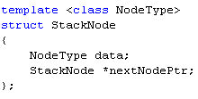
The StackNode Structure
Each node in the linked stack is implemented as a template structure consisting of two fields:
data of a generic data type NodeType
nextNodePtr which is a pointer to the next stack node

Slide 8
The LinkedStackType Class
LinkedStackType <Type>
*stackTop : StackNode
stackSize : int
LinkedStackType( )
initializeStack( ) : void
isEmptyStack( ) : boolean
push(Type ) : boolean
peek(Type ) : boolean
pop(Type ) : boolean
getStackSize( integer ) : void
printStack( ) : void
~LinkedStackType()
createNode( Type) : StackNode *

Slide 9
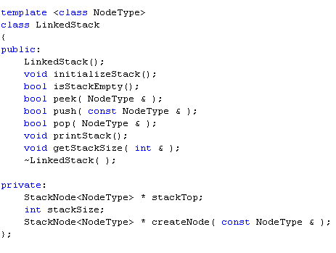
Implementing The LinkedStack Class

Slide 10
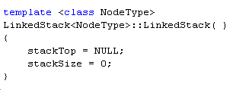
Implementing the Constructor
When stack object declared
Initializes stack to an empty state
Sets stackTop to NULL
Sets stackSize to 0

Slide 11
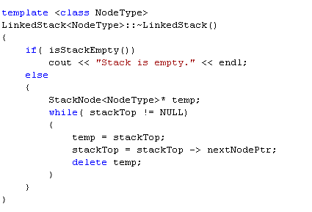
Implementing the Destructor
When the application ends, deallocate memory occupied by all stack nodes

Slide 12
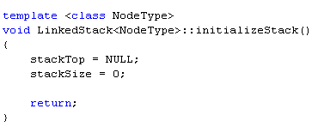
Initialize Stack
Reinitializes stack to an empty state

Slide 13
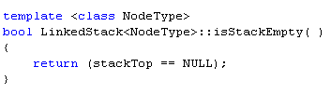
Empty Stack
Value of stackTop indicates if stack is empty
Stack is empty if stackTop is NULL
Stack is not empty otherwise

Slide 14
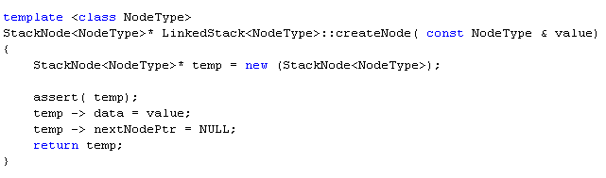
Utility Function: Create New Node
Called when a new stack node needs to be created
Function push
Returns a dynamically allocated StackNode object

Slide 15

Push
A newly created stack node is added at the beginning of the linked stack pointed to by stackTop
Value of pointer stackTop updated
Stack before the push operation

Slide 16
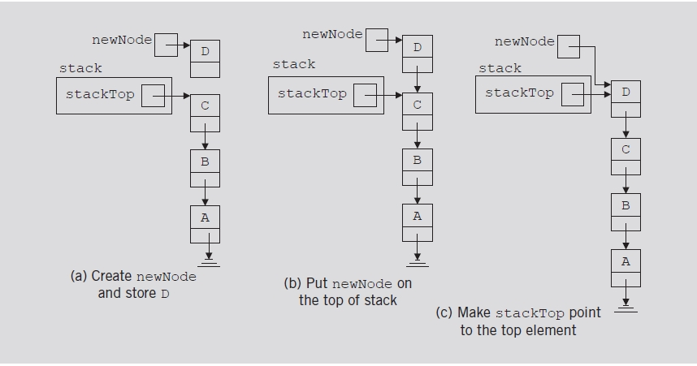
Push (cont’d.)

Slide 17
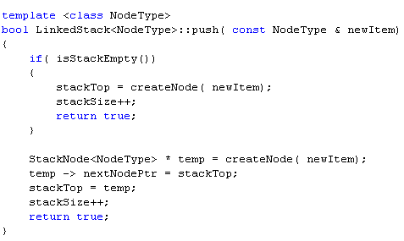
Push (cont’d.)

Slide 18
Pop
Removes top element of the stack
Node pointed to by stackTop removed
Value of pointer stackTop updated
Stack before the pop operation

Slide 19
Pop (cont’d.)

Slide 20
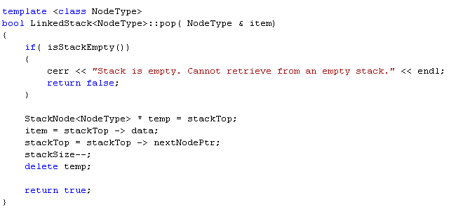
Pop (cont’d.)

Slide 21
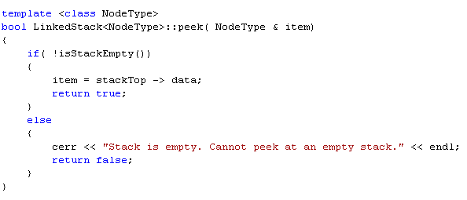
Peek
Returns information of the node to which stackTop pointing

Slide 22
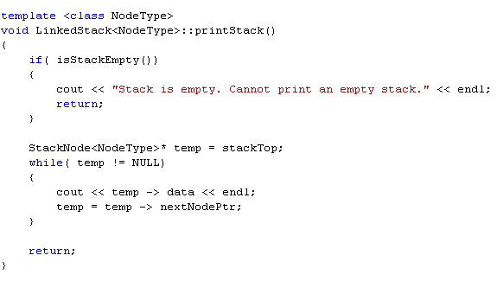
Print
Display contents of the stack

Slide 23
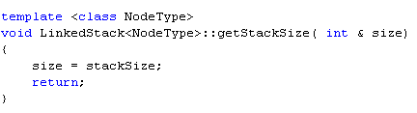
Utility Function: Stack Size

Slide 24
Testing the LinkedStack Class: Parentheses Matching
Write a program that uses a stack to test if parentheses in a given expression match. That is, for each left parenthesis there is a matching right parenthesis and for each right parenthesis there is a matching left parenthesis.

Slide 25
Section 3 - End

